Slide 1
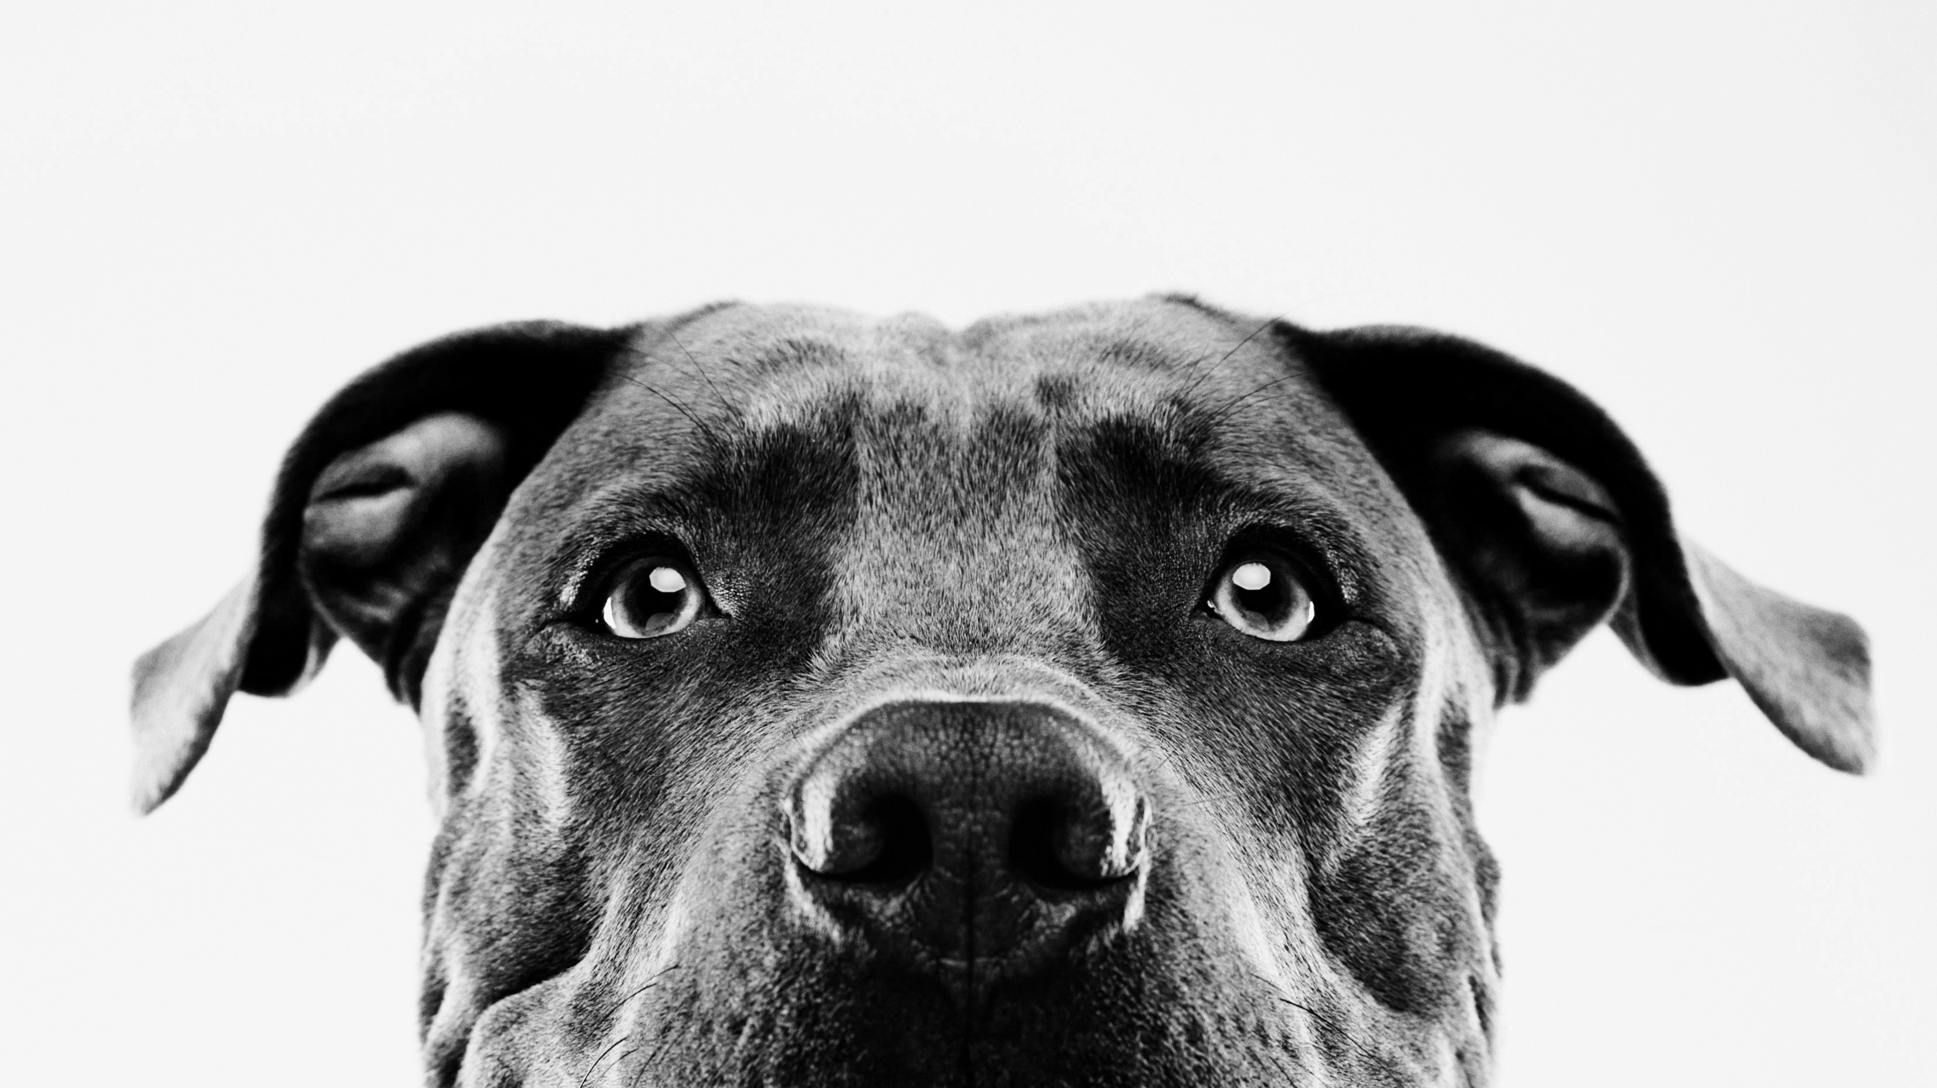
Generating Pictures of Dogs (Using their Breed name)
Vinh Le

Slide 2
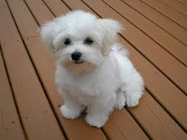
The Plan
GAN
But with cute dogs (attempted with cats)
Instead of training generator and discriminator simultaneously
Train discriminator first
Input text → Image
Breed of dog
Dataset: http://vision.stanford.edu/aditya86/ImageNetDogs/
“maltese”

Slide 3
Train Images
Pre-Trained VGG16
“the discriminator”
Labels as one-hot vectors
Images
Gen. Loss
Disc. Loss
Train Labels
Generator
Random Noise

Slide 4
What Happened
Training the discriminator to recognize breeds did work!
5 Breeds(Pug, Maltese, Great Dane, RedBone, Beagle)

Slide 5
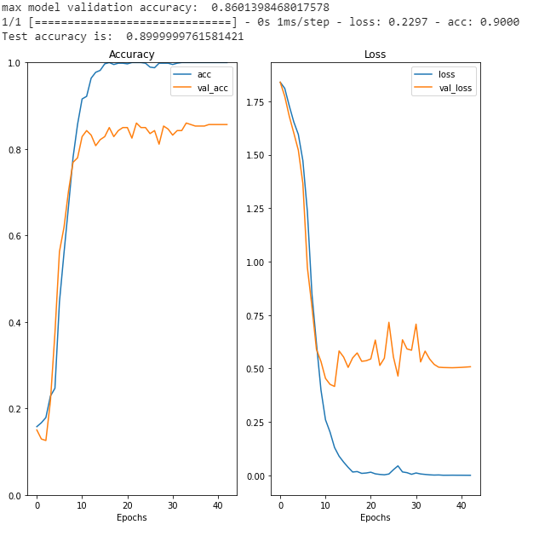
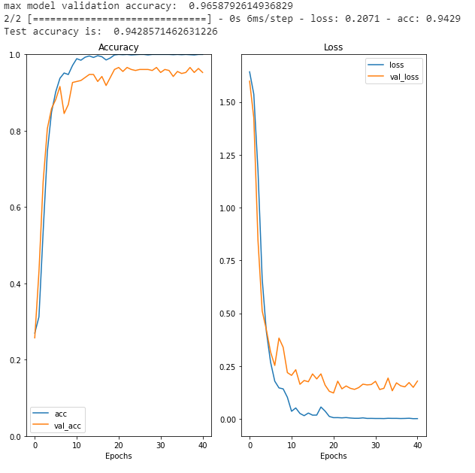
Basic Transfer Learning with VGG16 Backbone
Extra Dense Layer, Leaky ReLU
Augmented Data, and more

Slide 6
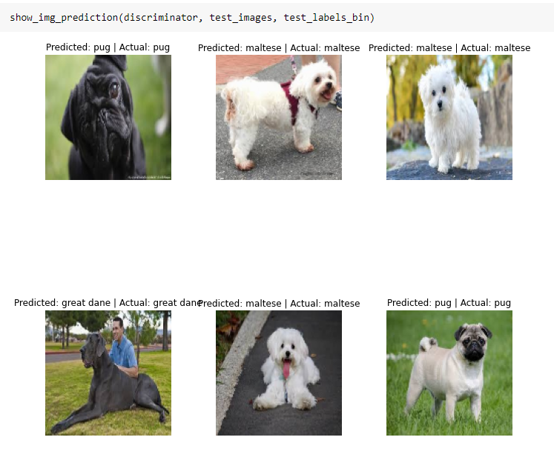

Slide 7
What Else?
Many errors while trying to create manual training
Matching the input output sizes
Gradients wouldn’t save
Figuring out exactly what input for generator to take/loss function
Cannot use high level functions(or np funcs) while creating low level

Slide 8
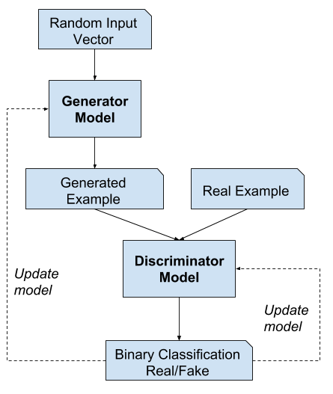
What Now?
Back to the traditional GAN
Sadly there can’t be text -> image capabilities but hopefully there’s at least dog creation abilities.

Slide 9
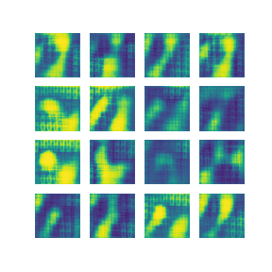
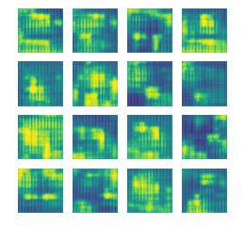
Results
GAN going through 1000 epochs
Sometimes it kind of has the shape of a dog?
GAN @ 1000th epoch
Sometimes it kind of has the shape of a dog?

Slide 10
Things to Consider
Still not done!
Altering learning rates
Changing/adding: warmup/decay/baseline
RAdam, More Epochs, More Data Augmentation
Trying again to have a baseline discriminator

Slide 11
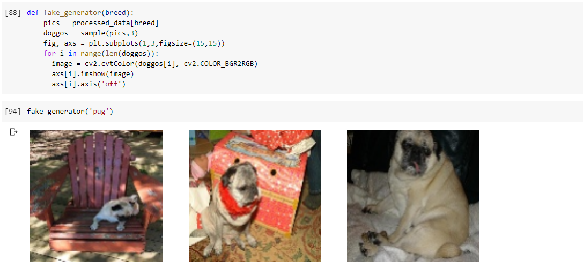
Backup Plan/Thanks!/Questions?
REFS:
https://www.tensorflow.org/tutorials/customization/custom_training_walkthrough
https://arxiv.org/pdf/1710.10916v3.pdf

